Slide 1
Count-Min Sketch: An Introduction and Use Case
Efficient Frequency Estimation in Streaming Data
-Suman Indla

Slide 2
Introduction to Count-Min Sketch
The Count-Min Sketch is a probabilistic data structure used for approximate frequency estimation in streaming data. It efficiently addresses the challenge of estimating the frequencies of various elements in a large data stream using limited memory. By employing multiple hash functions and an array of counters, the Count-Min Sketch provides a memory-efficient way to estimate frequencies while sacrificing some accuracy. It finds applications in scenarios where real-time processing of high-cardinality data is required, such as website traffic analysis, network monitoring, and more.

Slide 3
Purpose and benefits
The Count-Min Sketch serves the purpose of efficiently estimating the frequencies of elements in streaming data while offering several key benefits:
Memory Efficiency: The Count-Min Sketch uses a fixed amount of memory regardless of the number of distinct elements in the data stream. This makes it suitable for scenarios where memory is limited, as it can handle high-cardinality data streams without significantly increasing memory requirements.
Real-Time Processing: The Count-Min Sketch allows for real-time processing of streaming data. It incrementally updates its counters as new elements are encountered in the data stream, enabling timely estimations of element frequencies without requiring access to the entire data history.
High Cardinality Support: Count-Min Sketch is effective in estimating frequencies even when dealing with a large number of distinct elements. It spreads the counts across multiple hash functions and counters, mitigating the issue of hash collisions and providing accurate estimations for high-cardinality datasets.

Slide 4
Purpose and benefits
Approximate Frequency Estimation: While not providing exact counts, the Count-Min Sketch delivers approximate frequency estimates with controlled error bounds. This trade-off between accuracy and memory efficiency makes it suitable for scenarios where precise counts are not essential.
Parallel Processing: Count-Min Sketch can be easily parallelized across multiple processors or nodes, making it well-suited for distributed computing environments where data streams need to be processed concurrently.
Scalability: As the size of the data stream increases, the Count-Min Sketch's accuracy can be enhanced by increasing the number of hash functions and counters, allowing it to adapt to changing data characteristics.
Diversity of Applications: Count-Min Sketch finds applications in various domains, including website traffic analysis, network traffic monitoring, social media trend detection, recommendation systems, and more. Its ability to handle large data streams and provide quick insights is valuable in many real-world scenarios.
In essence, the Count-Min Sketch balances memory efficiency and accuracy, making it a powerful tool for processing and analyzing massive data streams in situations where precise counts are not necessary but timely insights are crucial.

Slide 5
Use cases
The Count-Min Sketch has versatile use cases across various domains due to its ability to efficiently estimate frequencies in data streams. Here are some notable use cases:
Website Traffic Analysis: In high-traffic websites, the Count-Min Sketch can estimate the popularity of different pages or content in real-time. This helps in optimizing content placement and enhancing user experience.
Network Traffic Monitoring: Count-Min Sketch is used to analyze network traffic patterns, identifying the most frequent network requests or potential security threats in large-scale network environments.
Social Media Trend Detection: By estimating the frequency of specific hashtags, keywords, or topics in social media feeds, the Count-Min Sketch aids in detecting trending discussions and popular content.

Slide 6
Use cases
Recommendation Systems: Count-Min Sketch can estimate user interactions with products, videos, or articles, supporting recommendation algorithms that suggest relevant items based on their estimated popularity.
Click-Through Rate Analysis: In online advertising, the Count-Min Sketch helps estimate the click-through rates of different ads or campaigns, assisting advertisers in optimizing their marketing strategies.
Stream Analytics: Count-Min Sketch is used in stream analytics platforms to analyze data flows in real-time, providing insights into the frequency of various events or data points.
Distributed Data Aggregation: In distributed systems, the Count-Min Sketch is employed to aggregate data across multiple nodes while minimizing communication overhead and memory usage.

Slide 7
Use cases
Traffic Engineering: Count-Min Sketch can estimate traffic patterns in road networks, helping in traffic management, route optimization, and congestion prediction.
Monitoring System Health: The Count-Min Sketch aids in monitoring the frequency of system events, errors, or anomalies in IT infrastructure, allowing timely responses to issues.
DNA Sequence Analysis: Count-Min Sketch is used to estimate the frequency of DNA sequences in bioinformatics, aiding in sequence comparison and analysis.
These use cases showcase the Count-Min Sketch's versatility in addressing challenges related to frequency estimation in various data streams, making it a valuable tool in data analysis, real-time processing, and decision-making across diverse industries.

Slide 8
Key Takeaway:
The Count-Min Sketch is a valuable tool for estimating element frequencies in streaming data, offering memory efficiency, real-time processing, and versatility in various applications.

Slide 9
How Count-Min Sketch Works
Structure Overview:
The Count-Min Sketch consists of an array of counters organized into rows and columns.
Multiple hash functions are employed to map elements to specific counters.
Hash Functions:
The key to the Count-Min Sketch's efficiency lies in the use of multiple hash functions.
For each element, multiple hash functions are applied to generate multiple hash values.
Each hash function corresponds to a specific row of counters.
Counters and Hashing:
Hash values are used as indices to access counters within each row.
Elements are hashed to different counters across various rows.

Slide 10
How Count-Min Sketch Works
Incrementing Counters:
When an element is encountered in the data stream, the corresponding counters are incremented.
Each hash function contributes to the increment of a counter within its row.
Probabilistic Estimation:
Due to the multiple hash functions, some counters might be incremented more than once for a single element, leading to overestimation.
However, overestimation is balanced by underestimation, resulting in accurate approximate frequency estimates on average.
Retrieval of Frequency Estimates:
To estimate the frequency of an element, hash functions are applied, and the minimum value among the counters in the corresponding rows is retrieved.
The minimum value represents the lowest possible count for that element across the various hash functions.

Slide 11
How Count-Min Sketch Works
Benefits of Hash Function Diversity:
Hash collisions are expected but are spread across multiple counters due to diverse hash functions.
The spread of collisions reduces the impact of overestimation and provides more accurate estimates.
Trade-Off:
Count-Min Sketch achieves memory efficiency by trading off some accuracy. The more counters and hash functions used, the better the accuracy, but at the cost of increased memory consumption.

Slide 12
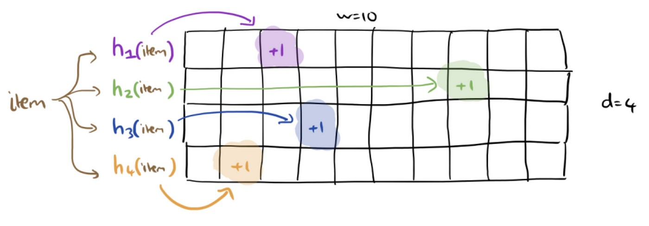
How Count-Min Sketch Works
Count-Min sketch
2D Matrix
No of rows = no. of hash functions (more hash function ~ more accuracy)
No. of columns = no. of counters

Slide 13
Use Case Example: Website Traffic Analysis
Problem: Efficiently estimating the popularity of different pages on a high-traffic website.
Scenario: Imagine managing a popular e-commerce website with millions of daily visitors. You need to track which pages are most frequently visited to optimize content placement and enhance user experience.
Challenge: Traditional methods of counting visits for each page can be memory-intensive and slow, especially as the number of distinct pages increases.
Solution: Count-Min Sketch comes to the rescue!
How Count-Min Sketch Addresses the Problem:
Memory Efficiency: Count-Min Sketch uses a compact memory structure to estimate page visit frequencies without storing raw visit data.
Real-Time Estimation: As new visitors arrive, the Count-Min Sketch is updated in real-time, providing timely insights into page popularity.
High-Cardinality Handling: High-traffic websites often have a large number of distinct pages. Count-Min Sketch's multiple hash functions and counters efficiently estimate frequencies even for high-cardinality datasets.
Approximate Estimates: While providing fast and memory-efficient results, Count-Min Sketch offers approximate estimates that are sufficiently accurate for optimizing content placement.

Slide 14
Implementation Steps
Create a Count-Min Sketch instance with multiple hash functions and counters.
Simulate website traffic stream by recording pages visited by users.
Update the Count-Min Sketch with page visit information.
Estimate the frequency of specific pages to determine their popularity.

Slide 15
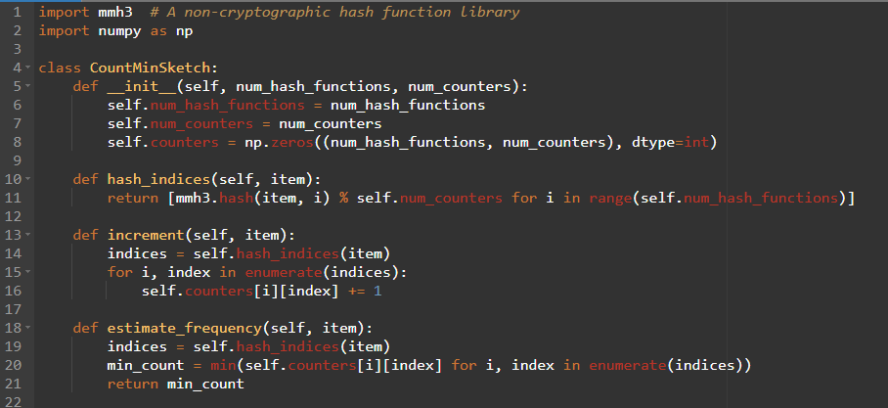
Implementation Steps

Slide 16
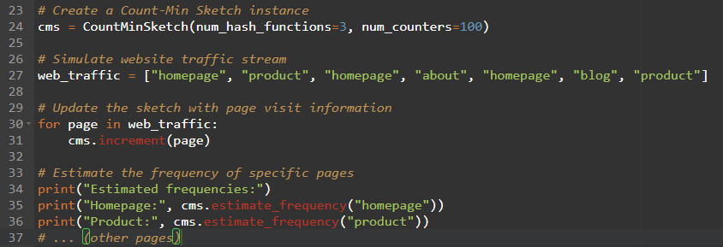
Implementation Steps

Slide 17
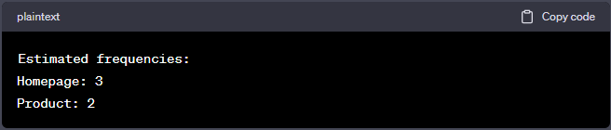
Results
Explanation of the output:
The word "homepage" appeared 3 times in the simulated website traffic.
The word "product" appeared 2 times in the simulated website traffic.
Keep in mind that the Count-Min Sketch provides approximate frequency estimates, so the estimated frequencies might not be exact but are usually close to the actual frequencies. The actual output could vary slightly due to the probabilistic nature of the Count-Min Sketch.

Slide 18
Advantages and Limitations
Advantages:
Requires minimal memory compared to storing individual counts.
Works well for large data streams and high cardinality of elements.
Supports real-time estimation of element frequencies.
Drawbacks:
It can overestimate frequencies due to hash collisions.
Cannot provide exact counts.
Key Takeaway: The Count-Min Sketch's advantages, such as memory efficiency and real-time processing, make it a valuable tool for frequency estimation in data streams. However, it's essential to consider its approximate nature and limitations in applications requiring precise counts or dealing with skewed data distributions.

Slide 19
Conclusion
The Count-Min Sketch is a probabilistic data structure used for estimating the frequency of elements in a data stream.
The Count-Min Sketch addresses situations where the exact frequency of elements is not needed, but approximate counts are sufficient.
Initialization: The Count-Min Sketch is initialized with a fixed number of hash functions and a fixed number of counters (buckets).
Updating Counts: As elements flow through the stream, the Count-Min Sketch is updated. For each element, it is hashed using each of the hash functions, and the corresponding counters are incremented.
Querying Frequencies: To estimate the frequency of an element, you hash it using the same hash functions and retrieve the values in the corresponding counters. The minimum value among these counters provides an estimate of the element's frequency.
Requires minimal memory compared to storing individual counts.
Works well for large data streams and high cardinality of elements.
It can overestimate frequencies due to hash collisions.
Cannot provide exact counts.

Slide 20
References
https://cse163.github.io/book/module-9-miscellaneous-topics/lesson-26-reading-hashing/optional-count-min-sketch.html
https://en.wikipedia.org/wiki/Count%E2%80%93min_sketch
https://www.geeksforgeeks.org/count-min-sketch-in-java-with-examples/
https://florian.github.io/count-min-sketch/

